Slide 1
R Markdown Presentation & Plotly
CHIJINDU OKPALAOKA
1, MARCH 2021

Slide 2
Instructions
Create a web page presentation using R Markdown that features a plot created with Plotly. Host your webpage on either GitHub Pages, RPubs, or NeoCities. Your webpage must contain the date that you created the document, and it must contain a plot created with Plotly. We would love to see you show off your creativity!
Notice
To run the presentation in R install:
Plotly with the command: install.packages("plotly")
load the library with: library(plotly)

Slide 3
Plotly: showing a 3D Scatterplot
using the mtcars package with the variables:
x…Weight(1000lbs)
y…mpg Miles/(US) gallon
z…hp Gross horsepower

Slide 4
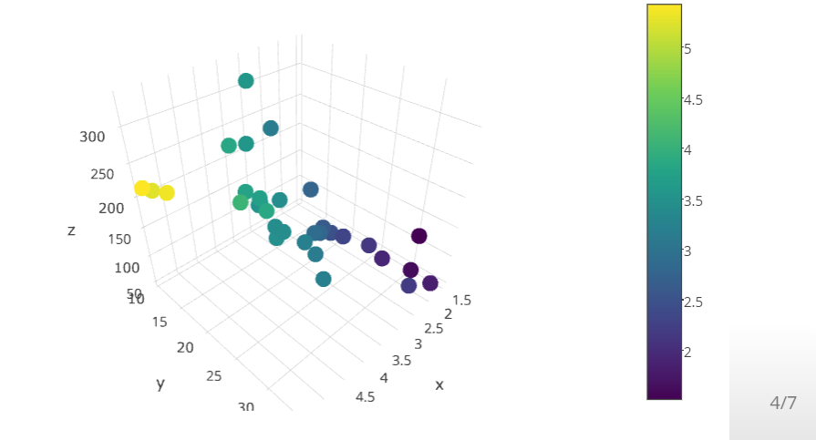
3D Scatterplot
library(plotly)
plot_ly(x=mtcars$wt,y=mtcars$mpg,z=mtcars$hp,type="scatter3d",
mode="markers", color=mtcars$wt

Slide 5
Plotly: showing Quarterly Approval Ratings of US Presidents
Description
The (approximately) quarterly approval rating for the President of the United States from the first quarter of 1945 to the last quarter of 1974.
Format
A time series of 120 values.

Slide 6
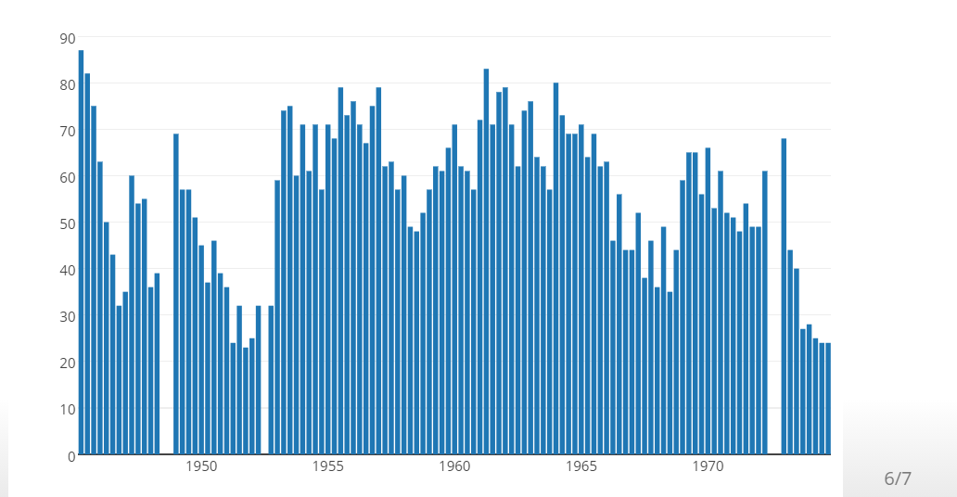
Bar plot
data("presidents")
plot_ly(x=time(presidents), y=presidents, type="bar")

Slide 7
Thank you

